Slide 1
Input Sort
Christophorus Jonathan Radit
23STI9015

Slide 2
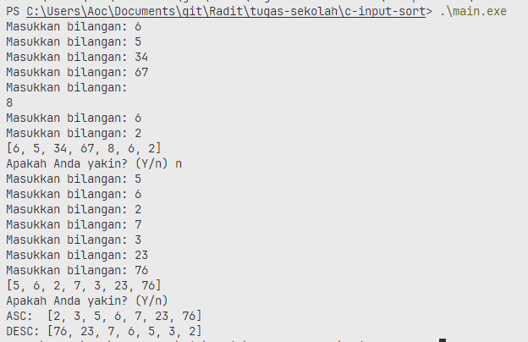
Screenshot

